Slide 1

Distributed Systems
Unit 3 PROCESSES
Ling ZHOU
School of Computer Science and Engineering
College of Software Engineering,
Southeast University, Nanjing
ling.zhou@seu.edu.cn
Notes:
内容有点多，不都是重点，大致了解即可

Slide 2

Unit 3 – Processes: Outline
Threads
Virtualization
Clients
Servers
Code migration
Summary

Slide 3
About the Process Issue
The concept of a process originates from the field of OS where it is generally defined as a program in execution
The most important issues
from an OS perspective: the management and scheduling of processes (most important issues)
From a DS perspective: other issues become equally or more important

Slide 4

Threads
Introduction to threads
Context switching
Relation among programs, processes and threads
Thread usage in non-distributed systems
Thread Implementation
User-level threads
Kernel-level threads
Hybrid form of the above two
Threads in distributed systems

Slide 5
Introduction to Threads
To execute a program, an OS creates a number of virtual processors in software, on top of physical processors, and keeps a process table:
Processor: Provides a set of instructions along with the capability of automatically executing a series of those instructions.
Thread: A minimal software processor in whose context a series of instructions can be executed.
Saving a thread context implies stopping the current execution and saving all the data needed to continue the execution at a later stage.
Process: A software processor in whose context one or more threads may be executed.
Executing a thread, means executing a series of instructions in the context of that thread.

Slide 6
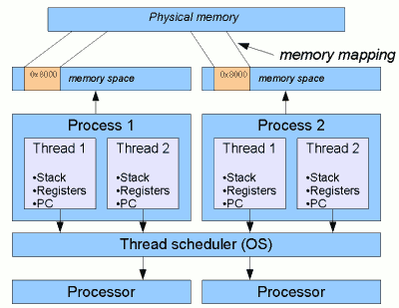
Threads and Processes: More Details
Typical relationship between processes, threads and various other elements of the OS
A thread is essentially a subdivision of a process, or "lightweight process" (LWP) on some systems.
A process is generally the most major and separate unit of execution recognized by the OS.
Crucially, each process has its own memory space.
Threads within a process share the same address space
0x8000
0x8000

Slide 7
Concurrency Transparency of Processes
The OS ensures that independent processes cannot maliciously or inadvertently affect the correctness of each other’s behavior
Concurrency transparency: Multiple processes may be concurrently sharing the same CPU and other hardware resources is made transparent (need hardware support)
Each time a process is created, the OS must create a complete independent address space.

Slide 8
Context Switching (1)
Contexts
Processor context: The minimal collection of values stored in the registers of a processor used for the execution of a series of instructions (e.g., stack pointer, addressing registers, program counter).
Thread context: The minimal collection of values stored in registers and memory, used for the execution of a series of instructions (i.e., processor context, state).
Process context: The minimal collection of values stored in registers and memory, used for the execution of a thread (i.e., thread context, but now also at least MMU register values, probably TLB).
<
<
MMU − Memory Management Unit
TLB − Translation Lookaside Buffer
Notes:
A translation lookaside buffer (TLB) is a cache that memory management hardware uses to improve virtual address translation speed. All current desktop, notebook, and server processors use a TLB to map virtual and physical address spaces, and it is nearly always present in any hardware which utilizes virtual memory.
data translation look-aside buffer. Performs the translation from linear addresses to physical address required for support of virtual memory.

Slide 9
Context Switching (2)
Observations
Threads share the same address space. Thread context switching can be done entirely independent of the operating system (OS).
Process switching is generally more expensive as it involves getting the OS in the loop, i.e., trapping to the kernel.
Switching the CPU between two processes =
saving the CPU context +
modifying MMU register values +
invalidating address translation caches (e.g., flushing the TLB)
If the OS supports more processes than it can simultaneously hold in main memory, it may have to swap processes between main memory and disk before the actual switch can take place
Conclusion: Creating and destroying threads is much cheaper than doing so for processes.

Slide 10
Why use threads
Some simple reasons
Avoid needless blocking: a single-threaded process will block when doing I/O; in a multi-threaded process, the operating system can switch the CPU to another thread in that process.
Exploit parallelism: the threads in a multi-threaded process can be scheduled to run in parallel on a multiprocessor or multicore processor.
Avoid process switching: structure large applications not as a collection of processes, but through multiple threads.

Slide 11
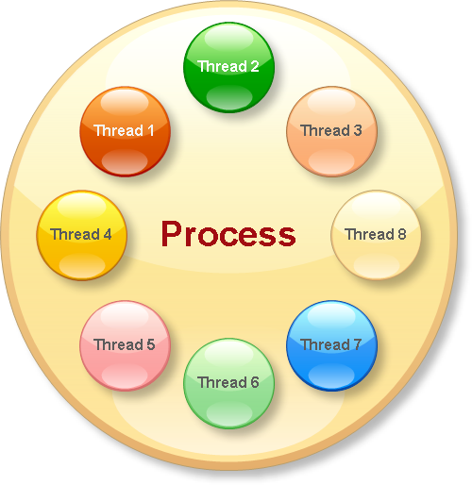
Summary About Relations Among Program, Processes and Threads
A program is an executable file, while a process is a program in execution.
Processes
independent execution units
contain their own state information
use their own address spaces
interact with each other via inter-process communication (IPC) mechanisms.
A single process might contains multiple threads
All threads within a process share the same state and same memory space, require less creation time, and can communicate with each other directly.
E.g., in MS word(a word processor),
separate threads can be used for:
handling user input, spelling and
grammar checking, document layout,
index generation, etc, which are all operating on the same data set

Slide 12



Relations Among Program, Processes and Threads (Table)
 | Definition | Address Space | State | Communication
Program | an executable file
Process | a program in execution | Use own address space | Contain own state | Via IPC
Thread | a subdivision of a process | Share the same address space | Share the same state | Communicate with each other directly

Slide 13

Thread Usage in Non-distributed Systems
Several benefits to multithreaded processes
In a single-threaded process, whenever a blocking system call is executed, the process is blocked
to have at least two threads of control
It is possible to exploit parallelism when executing the program on a multiprocessor system
Each thread is assigned to a different CPU while shared data are stored in shared main memory
Such parallelism can be transparent
Typically used for running servers in client-server applications
Multithreading is useful to structure large applications into parts that could be logically executed at the same time

Slide 14

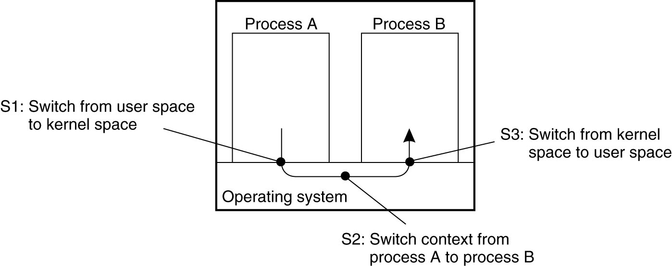
Multithreading in large applications
Large application: a collection of cooperating programs, each to be executed by a separate process
Drawback of all IPC mechanisms: extensive context switching
Different parts are executed by separate threads
Thread switching can sometimes be done entirely in user space or the kernel is aware of threads and schedules them
A dramatic improvement in performance

Slide 15


Threads: Avoid process switching
Trade-offs
Threads use the same address space: more prone to errors
No support from OS/HW to protect threads using each other’s memory
Thread context switching may be faster than process context switching

Slide 16
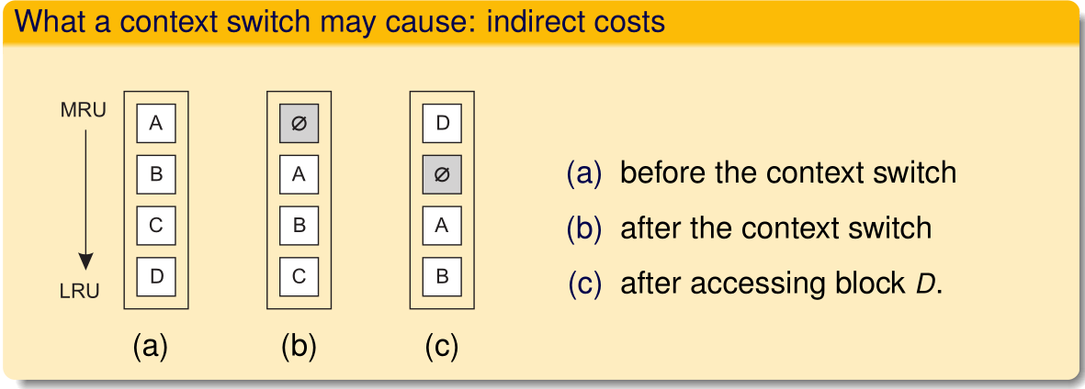
The cost of a context switch
Consider a simple clock-interrupt handler
direct costs: actual switch and executing code of the handler
indirect costs: other costs, notably caused by messing up the cache

Slide 17
Thread Implementation
Threads are often provided in the form of a thread package which contains operations: threads’ creation and destruction, synchronization variables
Two approaches to implement a thread package:
To construct a thread library that is executed entirely in user mode (user-level threads)
To have the kernel be aware of threads and schedule them (kernel-level threads)

Slide 18

User-level Threads (ULT) – Thread Libraries
All operations can be completely handled within a single process ⇨ implementations are efficient.
Cheap to create and destroy threads
Cheap thread context switching
All services provided by the kernel are done on behalf of the process in which a thread resides ⇨ if the kernel decides to block a thread, the entire process will be blocked.
Threads are used when there are lots of external events: threads block on a per-event basis ⇨ if the kernel can’t distinguish threads, how can it support signaling events to them?

Slide 19
Kernel-level Threads (KLT) – System Calls
The whole idea is to have the kernel contain the implementation of a thread package. ⇨ This means that all operations return as system calls
Operations that block a thread are no longer a problem: the kernel schedules another available thread within the same process.
Handling external events is simple: the kernel (which catches all events) schedules the thread associated with the event.
The big problem is the loss of efficiency due to the fact that each thread operation requires a trap to the kernel.
Switching thread contexts may become as expensive as switching process contexts

Slide 20
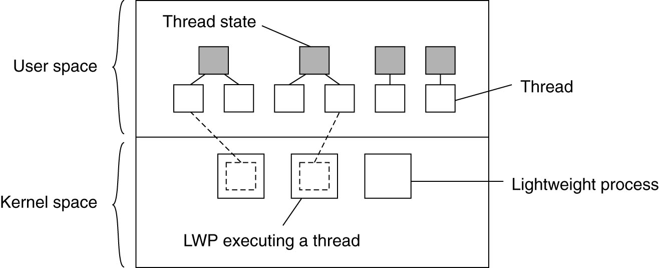
Hybrid form of user-level and kernel-level threads (Solaris Threads)
Introduce a two-level threading approach: lightweight processes (LWP) that can execute user-level threads.
Notes:
Lightweight processes (LWP) each LWP supports one or more ULTs and maps to exactly one KLT
Lightweight Process是有Kernel支援的user thread.也就是说,每个LWP,kernel 皆使用一个thread来处理/支援.于是LWP可以看成是kernel thread的延伸.操 作LWP的代价是很大的,因为他牵扯到Kernel的context switching.
Solaris是由一组Kernel threads所构成,有一些用来执行LWP,有些负责一些系统的 任务.
The Solaris kernel is multithreaded.
The kernel-visible execution context for a user thread.
Every thread in a user process is bound to an LWP, and each LWP has a kernel thread.

Slide 21
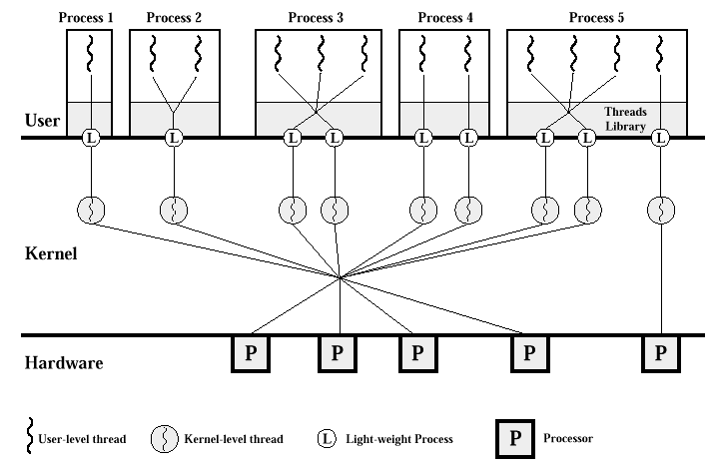
Solaris Threads (1)
LWPs bridge the user level and the kernel level, which are located between the ULTs and KLTs. These LWPs serve as a "Virtual CPUs" where user-threads can run.
Each process contains one or more LWP. Each LWP supports one or more ULTs and maps to exactly one KLT.
KLT: The object that gets scheduled and executed on a processor.
ULT: The user-level (non-kernel) thread state maintained within a user process.
Process: The executable form of a program; the execution environment for a user program.
LWP: The kernel-visible execution context for a user thread.
Notes:
The Solaris kernel is multithreaded.
Beginning in Solaris 9, there is a one-to-one relationship between user threads, LWPs, and kernel threads.
Every thread in a user process is bound to an LWP, and each LWP has a kernel thread.
The LWP allows each thread within a process to make system calls independently of other threads within the same process.
Without an LWP, only one thread could enter the kernel at a time. Only one thread at a time could make a system call.
Each time a system call is made by a thread, its registers are placed on a stack within the LWP. Upon return from a system call, the system call return codes are made available to the LWP. Figure 1.2 shows the relationship among user threads, LWPs, kernel threads, and processes.

Slide 22
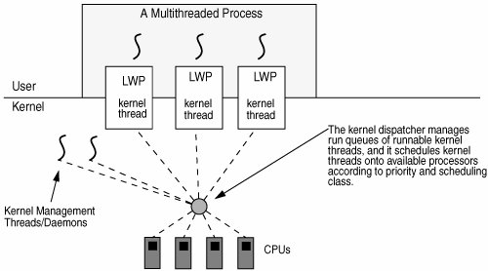
The Solaris kernel is multithreaded

Slide 23
Solaris Threads (2)
Solaris executes kernel threads for kernel-related tasks
such as interrupt handling, memory page management, device drivers, etc.
For user-process execution, kernel threads have a corresponding LWP
The LWP allows each thread within a process to make system calls independently of other threads within the same process. Without an LWP,
only one thread could enter the kernel at a time.
only one thread at a time could make a system call.

Slide 24
Lightweight Processes (LWPs) – Principle Operations
User-level thread does system call ⇨ the LWP that is executing that thread, blocks. The thread remains bound to the LWP.
The kernel can schedule another LWP having a runnable thread bound to it. Note: this thread can switch to any other runnable thread currently in user space.
A thread calls a blocking user-level operation ⇨ do context switch to a runnable thread, (then bound to the same LWP).
When there are no threads to schedule, an LWP may remain idle, and may even be removed (destroyed) by the kernel.
Drawback: Still need to create and destroy LWPs, which is as expensive as with KLT. But the operations happen only occasionally.

Slide 25
Advantages To Using LWPs In Combination With A User-level Thread Package
Creating, destroying, and synchronizing threads is relatively cheap and involves no kernel intervention at all.
Provided that a process has enough LWPs, a blocking system call will not suspend the entire process.
There is no need for an application to know about the LWPs. All it sees are user-level threads.
LWPs can be easily used in multiprocessing environments, by executing different LWPs on different CPUs. This multiprocessing can be hidden entirely from the application.
Only Drawback: Still need to create and destroy LWPs, which is as expensive as with KLT. But the operations happen only occasionally.

Slide 26
Threads in Distributed Systems
An important property of threads is that they can provide a convenient means of allowing blocking system calls without blocking the entire process.
This property makes threads particularly attractive to use in DS
easier to express communication in the form of maintaining multiple logical connections at the same time
Multithreaded clients
Multithreaded servers

Slide 27

Multithreaded Clients
To establish a high degree of distribution transparency, DS in WAN need to hide communication latency
The usual way is to initiate communication and immediately proceed
Typical example: Web browser as a multithreaded client
Start displaying data while it is still coming in
First fetch the main HTML file,
Separate threads can be activated to fetch the other parts
Several connections can be set up simultaneously to different server replicas ⇨ document can be fully displayed in a much shorter time

Slide 28
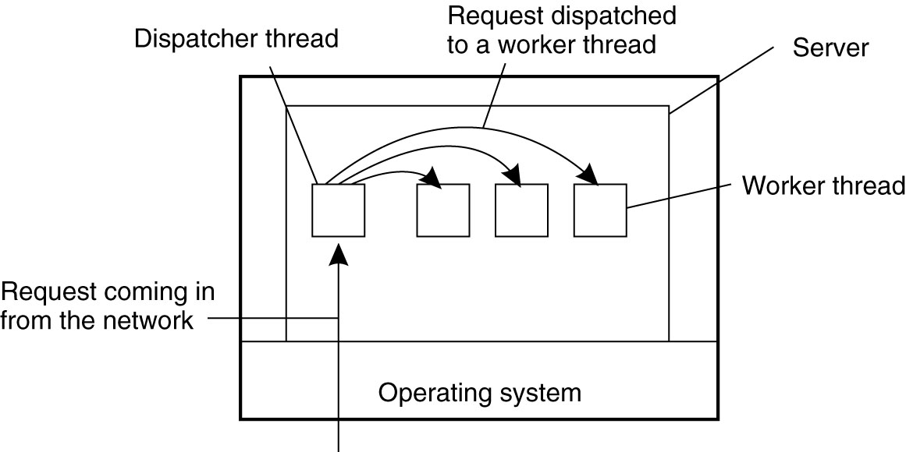
Multithreaded Servers
The main use of multithreading in DS is found at the server side
Simplify server code
Easier to develop servers that exploit parallelism to attain high performance, even on uni-processor systems
A multithreaded file server organized in a dispatcher/worker model

Slide 29
Using threads at the server side
Improve performance
Starting a thread is cheaper than starting a new process.
Having a single-threaded server prohibits simple scale-up to a multiprocessor system.
As with clients: hide network latency by reacting to next request while previous one is being replied.
Better structure
Most servers have high I/O demands. Using simple, well-understood blocking calls simplifies the overall structure.
Multithreaded programs tend to be smaller and easier to understand due to simplified flow of control.

Slide 30
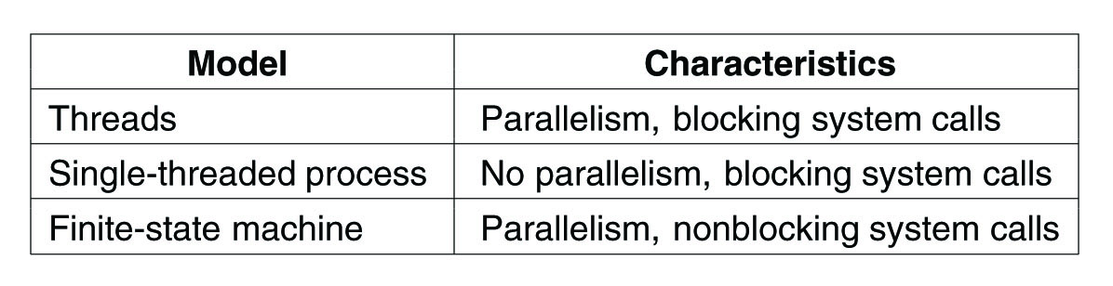
Three Ways to Construct a Server
Blocking system calls make programming easier and parallelism improves performance
Retains the ease and simplicity of blocking system calls, but gives up some amount of performance
Finite-state machine:
“sequential process” model is lost
The state of the computation must be explicitly saved and restored in the table for every message
Achieves high performance, but using nonblocking calls is hard for programming

Slide 31
Unit 3 – Processes: Outline
Threads
Virtualization
Clients
Servers
Code migration
Summary
Notes:
Brief history of modern computer era

Slide 32
Virtualization − Background
Threads and processes can be seen as a way to do more things at the same time ⇨ build programs that appear to be executed simultaneously
On a single-processor computer, this simultaneous execution is an illusion
Only an instruction from a single thread or process will be executed at a time
By rapidly switching between threads and processes, the illusion of parallelism is created
This idea can be extended to other resources, leading to resource virtualization.

Slide 33
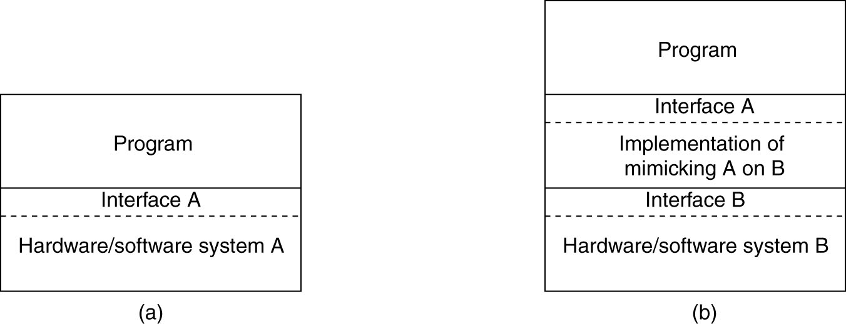
The Role of Virtualization in DS
Reasons why virtualization becomes an important mechanism for DS:
Hardware changes than software (e.g., OS)
Virtualization helps porting the legacy interfaces to the new platforms
Ease of portability and code migration
Virtualization helps reducing the diversity of platforms and machines by letting each application run on its own virtual machine.
Isolation of failing or attacked components
faster
Virtualization deals with extending or replacing an existing interface so as to mimic the behavior of another system
General organization between a program, interface, and system.
General organization of virtualizing system A on top of system B

Slide 34
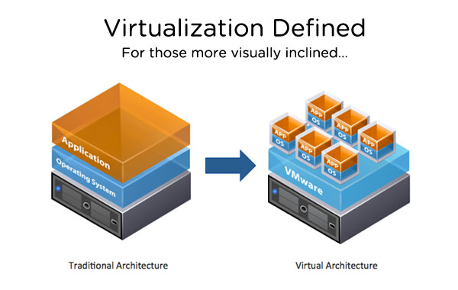
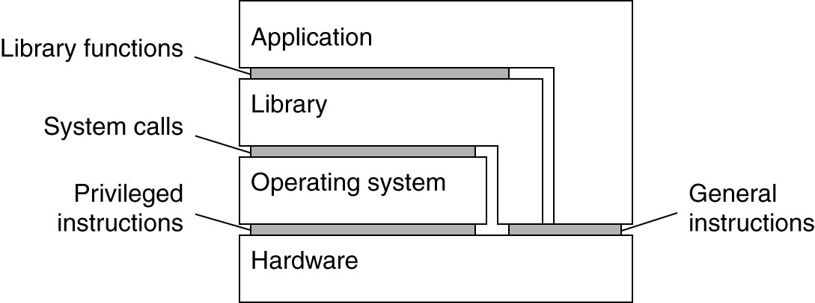
Architectural of Virtual Machines (VMs)
Virtualization can take place at very different levels, strongly depending on the interfaces as offered by various systems components
The essence of virtualization is to mimic the behavior of these interfaces
④ API
③
① Machine instructions
②
Various interfaces offered by computer systems
Notes:
Computer system generally offer four different types of interfaces, at four different levels.

Slide 35
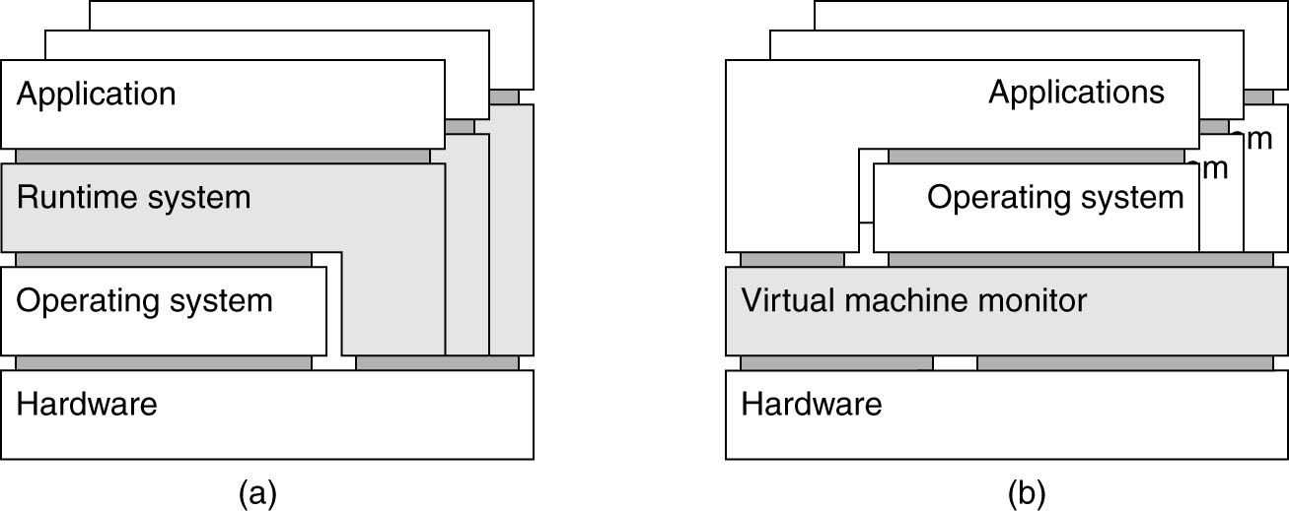
Process VMs versus VM Monitors
Virtualization can take place in two different ways
Process VM: A program is compiled to intermediate (portable) code, which is then executed by a runtime system (Example: Java VM).
VM Monitor (VMM): A separate software layer mimics the instruction set of hardware ⇨ a complete operating system and its applications can be supported (Example: VMware, VirtualBox).
Notes:
Virtualization can take place in two different ways.

Slide 36

VM Monitors on operating systems
VMMs run on top of existing operating systems.
Multiple and different systems run independently and concurrently on the same platform
Perform binary translation: while executing an application or operating system, translate instructions to that of the underlying machine.
VMMs will become increasingly important in the context of reliability and security for DS.
Isolation of failing or attacked components due to allowing for isolation of a complete application and its environment,
Portability is greatly improved as VMMs provide a further decoupling between hardware and software

Slide 37
VMs and cloud computing
Three types of cloud services
Infrastructure-as-a-Service (IaaS) covering the basic infrastructure
Platform-as-a-Service (PaaS) covering system-level services
Software-as-a-Service (SaaS) containing actual applications
IaaS
Instead of renting out a physical machine, a cloud provider will rent out a VM (or VMM) that may possibly be sharing a physical machine with other customers
⇒ almost complete isolation between customers (although performance isolation may not be reached).

Slide 38
Unit 3 – Processes: Outline
Threads
Virtualization
Clients
Servers
Code migration
Summary

Slide 39
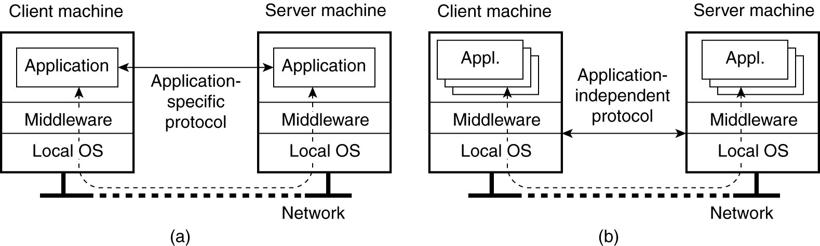
Clients: User Interface
A major task of client machines is to provide the means for users to interact with remote servers.
Supported two ways:
A networked application with its own protocol
E.g., an agenda running on a PDA that needs to synchronize with a remote shared agenda
A networked user interface: a general (application neutral) solution to allow access
to remote applications
Thin-client approach is more popular
Notes:
In the case of networked user interfaces, everything is processed and stored at the server.
This thin-client approach is receiving more attention as Internet connectivity increases, and hand-held devices are becoming more sophisticated.

Slide 40
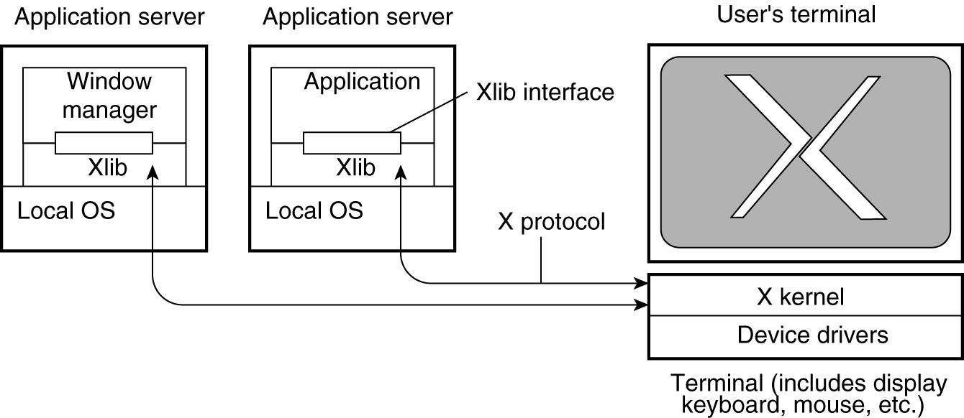
Oldest Networked User Interface Example: The X Window System
A major part of client-side software is focused on (graphical) user interfaces.
X allows many people to share the processing power of a time-sharing computer and to collaborate with each other through client applications running on remote computers
Thin client
Heart of the system
The interesting aspect of X is that the X kernel and the X applications need not necessarily reside on the same machine
Notes:
It is interesting to note how the X window system actually fits into client-server computing. From what we have described so far, it should be clear that the X kernel
receives requests to manipulate the display. It gets these requests from (remote) applications. In this sense, the X kernel acts as a server, while the applications
play the role of clients.
This terminology has been adopted by X, and although strictly speaking is correct, it can easily lead to confusion.
In computing, the X Window System (X11, X, and sometimes informally X-Windows) is a windowing system for bitmap displays, common on UNIX-like operating systems.

Slide 41
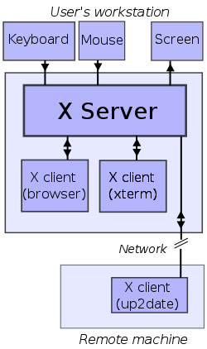
X terminal
An X terminal is a thin client that only runs an X server.
This architecture became popular for building inexpensive terminal parks for many users to simultaneously use the same large computer server to execute application programs as clients of each user's X terminal.
All relevant data is assumed to exist solely on the remote server
The X terminal user has no methods available to save or load data from a local terminal device such as a floppy disk, CDROM, or USB storage device.

Slide 42
Clients: User Interface – Compound Documents
Defined as a collection of documents, possibly of very different kinds, which are seamlessly integrated at the user-interface level
A user interface can handle compound documents hides the fact that different applications operate on different parts of the document
User interface is application-aware ⇨ inter-application communication:
drag-and-drop: move objects across the screen to invoke interaction with other applications
E.g., moving an icon representing a file A to an icon representing a trash can ⇨ the file is deleted
in-place editing: integrate several applications at user-interface level (word processing + drawing facilities)

Slide 43
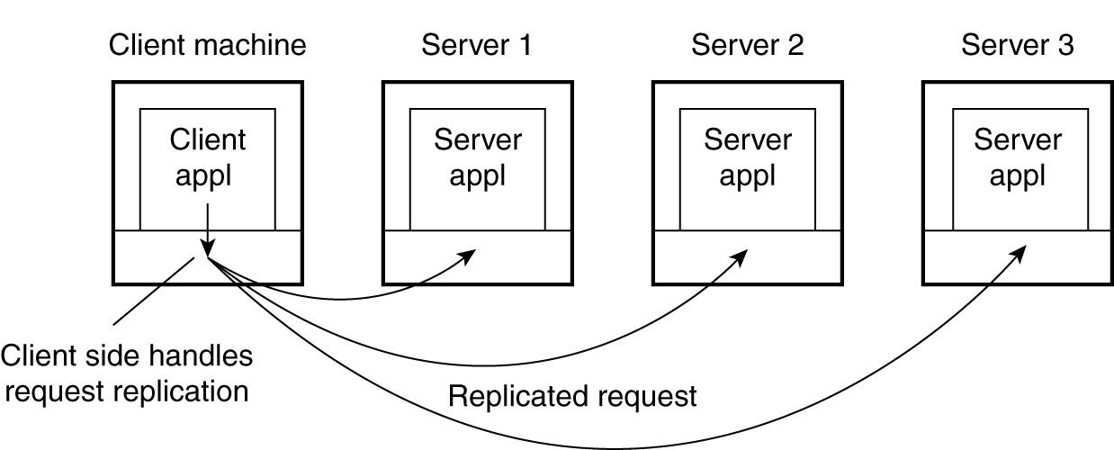
Client-Side Software for Distribution Transparency
access transparency: client-side stubs for RPCs
location/migration/relocation transparency: let client-side software keep track of actual location
replication transparency: multiple invocations handled by client stub:
failure transparency: can often be placed only at client (we’re trying to mask server and communication failures)
Concurrency/persistence transparency: handled at the server
Client-side software can transparently collect all responses and pass a single response to the client application
Notes:
Client software comprises more than just user interfaces. A special class is formed by embedded client software, such as for ATMs, cash registers, barcode readers, TV set-top boxes, etc.
In these cases, the user interface is a relatively small part of the client software, in contrast to the local processing and communication facilities.
Besides the user interface and other application-related software, client software comprises components for achieving distribution transparency.
Ideally a client should not be aware that it is communicating with remote processes.
In contrast, distribution is often less transparent to servers for reasons of performance and correctness.
For example, in Chap. 6 we will show that replicated servers sometimes need to communicate in order to establish that operations are performed in a specific order at each replica.
j2ee里面的stub是这样说的..为屏蔽客户调用远程主机上的对象，必须提供某种方式来模拟本地对象,这种本地对象称为存根(stub),存根负责接收本地方法调用,并将它们委派给各自的具体实现对象

Slide 44
Unit 3 – Processes: Outline
Threads
Virtualization
Clients
Servers
Code migration
Summary
Notes:
Brief history of modern computer era

Slide 45
Servers: General Organization
A server is a process that waits for incoming service requests at a specific transport address. In practice, there is a one-to-one mapping between a port and a service.
service | port | comment
ftp-data | 20 | File Transfer [default data]
ftp | 21 | File Transfer [control]
http | 80 | For the WWW
telnet | 23 | Telnet
 | 24 | Any private mail system
smtp | 25 | Simple mail transfer
login | 49 | Login Host Protocol
Port numbers have been assigned by the Internet Assigned Numbers Authority (IANA)

Slide 46
Type of servers
Iterative servers: handles both the connection request and the transaction involved in the call itself.
only one client at a time: request processing blocks any other connections
fairly simple and are suitable for transactions that do not last long; however, if the transaction takes more time, queues can build up quickly.
Concurrent servers: does not handle the request itself, but passes it to a separate thread or another process, which is responsible for returning a response (e.g., multithreaded server)
can take requests from multiple clients and assign them to helper threads

Slide 47
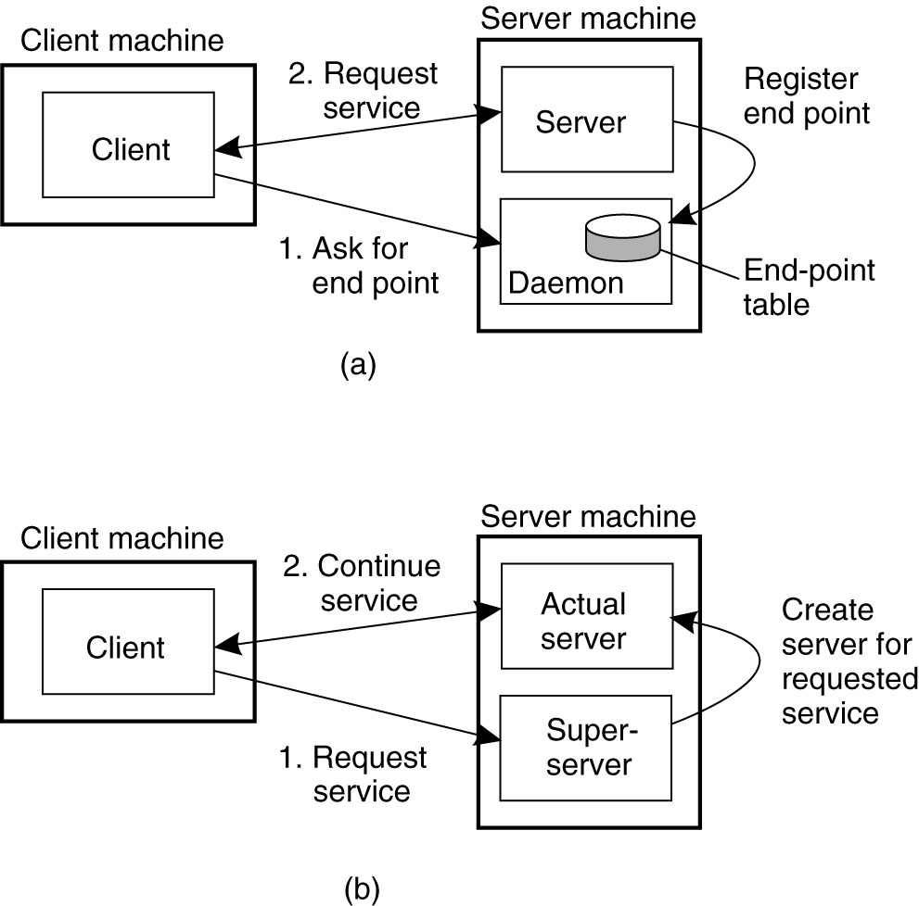
Servers: General Design Issues
Many services do not require a pre-assigned end point (i.e., port number), which can be dynamically assigned by its local OS
A client will first look up the end point. There are two solutions
A special daemon, running on the server machine, keeps track of the current end point of each service
A client
will first contact the daemon, request the end point
Then contact the server
Implementing each service by means of a separate server may be a waste of resources.
Having a single superserver listening to each end point associated with a specific service

Slide 48
Issue about Whether and How a Server Can Be Interrupted
Solution 1 : Use a separate port for urgent data:
Server has a separate thread/process for urgent messages
Urgent message comes in  associated request is put on hold
Note: OS is required to support priority-based scheduling
Solution 2: Use out-of-band communication facilities of the transport layer:
Example: TCP allows for urgent messages in same connection
Urgent messages can be caught using OS signaling techniques

Slide 49

Servers and State: Stateless Servers
Stateless servers: does not keep accurate information on the state of its clients and can change its own state without having to inform any client (e.g., Web server):
Don’t record whether a file has been opened (simply close it again after access)
Don’t promise to invalidate a client’s cache
Don’t keep track of your clients
Consequences:
Clients and servers are completely independent
State inconsistencies due to client or server crashes are reduced
Possible loss of performance because, e.g., a server cannot anticipate client behavior (think of prefetching file blocks)
Note: Many stateless server actually does maintain information on its clients, but this information can be lost later
Soft state (a particular form of a stateless design): the server maintains soft state for a limited time

Slide 50
Servers and State: Stateful Servers
Stateful servers: Keeps track of the status of its clients ⇨ the information needs to be explicitly deleted by the server:
Record that a file has been opened, so that prefetching can be done
Knows which data a client has cached, and allows clients to keep local copies of shared data
Observation: The performance of stateful servers can be extremely high, provided clients are allowed to keep local copies. As it turns out, reliability is not a major problem.
Drawback: If the stateful server crashes, it has to recover its entire state
In a stateless design, no need for recovering, simply starts running again

Slide 51
Choice for a Stateless and Stateful design
Note: When designing a server, any choice should not affect the services provided by server
If files have to be opened before they can be read from or written to
We need a stateless server
Solution: a server responds to a read or write request by first opening the referred file, read/write, after that immediately closes the file again
A server may want to keep a record on a client’s behavior so that it can more effectively respond to its request
We need a stateful server

Slide 52
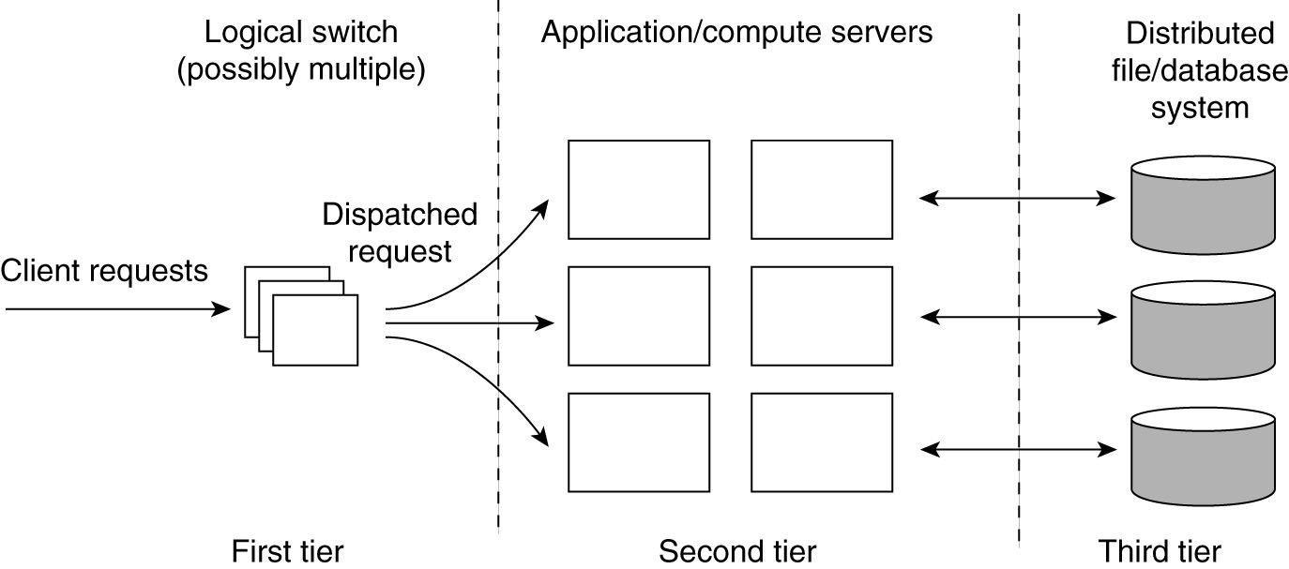
Server Clusters: General Organization
Definition: A collection of machines connected through a network, where each machine runs one or more servers
The network for connection we consider here is LAN offering high bandwidth and low latency
Logically organized into three tiers
Application processing servers
Data-processing servers
Computing bottleneck
Storage bottleneck
Notes:
The first tier consist of a (logical) switch through which client requests are routed. Such a switch can vary widely.
For example, transport-layer switches accept incoming TCP connection requests and pass requests on to one of servers in the cluster.
A completely different example is a Web server that accepts incoming HTTP requests, but that partly passes requests to application servers for further processing only to
Later collect results and return and HTTP response.

Slide 53
Server Clusters: Design goal
Important design goal: Hide the fact that there are multiple servers, i.e., client applications running on remote machines need not to know the internal organization of the cluster
Access transparency is invariably offered by means of a single access point, implemented through a dedicated machine, i.e., a switch
Most server clusters offer a single access point. When that point fails, the cluster become unavailable
For scalability and availability, a server cluster may have multiple access points
e.g., DNS can return several addresses, all belong to the same host name
Observation: Having the first tier handle all communication from/to the cluster may lead to a bottleneck.
Popular solution to the case of a single access point: TCP handoff
Notes:
A standard way of accessing a server cluster is to set up a TCP connection over which application-level requests are then sent as part of a session.
A session ends by tearing down the connection.
In the case of transport-layer switches, the switch accepts incoming TCP connection requests, and hands off such connections to one of the servers.
The principle working of what is commonly known as TCP handoff.

Slide 54
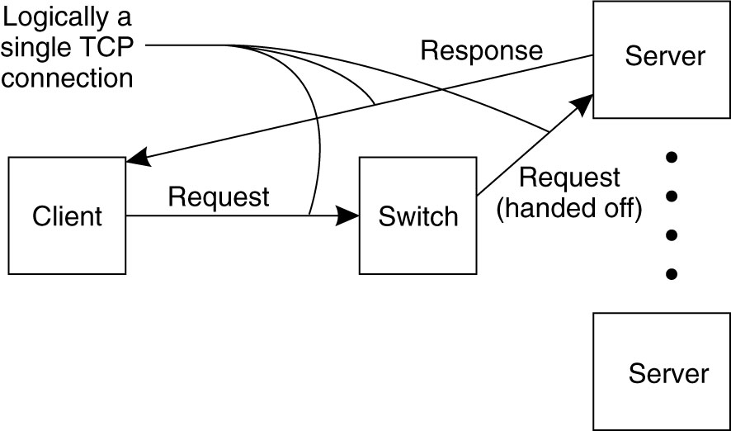
Request Handling and Load Balancing
The server sends an acknowledgment back to the requesting client, but inserting the switch’s IP address as the source field of the header of the IP packet
The spoofing is necessary for the client to continue executing the TCP protocol:
It is expecting an answer back from the switch, not from some arbitrary server it has never heard of before
A TCP-handoff implementation requires OS level modification
The switch plays an important role in distributing the load among the servers
Round robin
Content-aware request distribution

Slide 55
Distributed Servers (1)
Background:
Having stability, like a long-living access point, is a desirable
from a client’s and a server’s perspective
to have a high degree of flexibility in configuring a server cluster and the switch
Definition:
A distributed server is a possibly dynamically changing set of machines, with also possibly varying access points, but appears to the outside world as a single, powerful machine

Slide 56
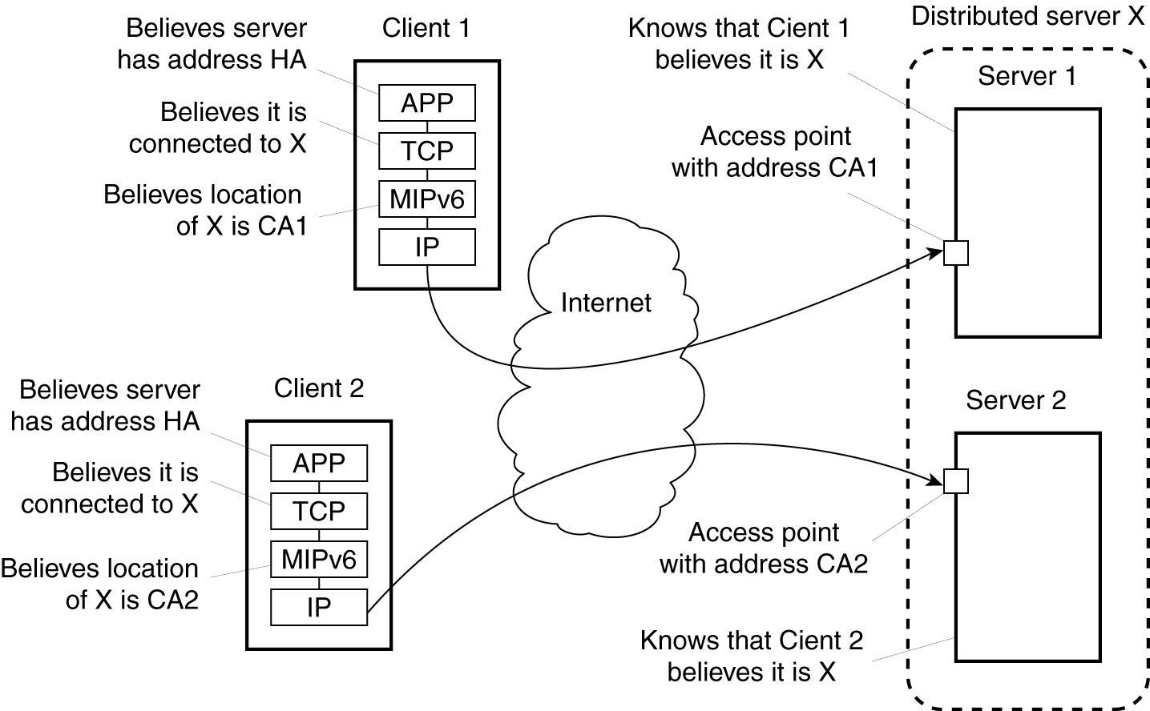
How to achieve a stable access point?
Route optimization in a distributed server:
to make different clients believe they are communicating with a single server, where, in fact, each client is communicating with a different member node of the distributed server

Slide 57
Managing Server Clusters
Common approaches
To extend the traditional managing functions of a single computer to that of a cluster
The administrator can log into a node from a remote client and execute local managing commands to monitor, install, and change components
More advanced approach – centralized administration:
to hide the fact that you need to login into a node and instead provide an interface at an administrator machine that allows to do most operations (e.g., IBM Cluster Systems Management)
Advantage: collective operations are more easily provided
Support for very large server clusters is almost always ad hoc. Cluster management is in its infancy and self-managing solutions may help

Slide 58
Example: PlanetLab (1)
PlanetLab is a group of computers available as a testbed for computer networking and distributed systems research (e.g., distributed storage, network mapping, peer-to-peer systems, distributed hash tables, and query processing.)
Essence
Different organizations contribute machines, which they subsequently share for various experiments.
Problem
We need to ensure that different distributed applications do not get into each other’s way ⇨ virtualization

Slide 59
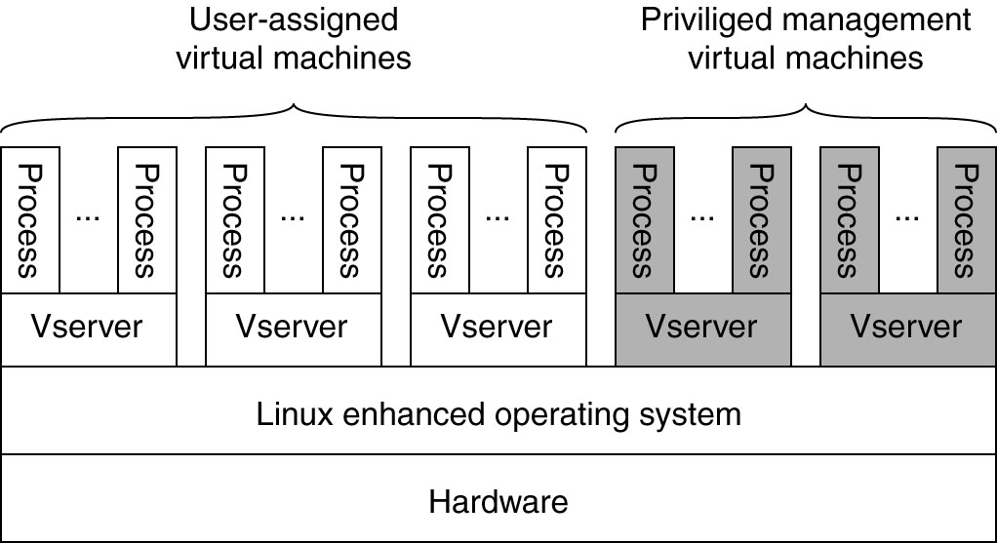
Example: PlanetLab (2)
Vserver: Independent and protected environment with its own libraries, server versions, and so on. Distributed applications are assigned a collection of vservers distributed across multiple machines (slice).
A slice can be thought of as a virtual server cluster
Programs from different slices but running on the same node should not interfere with each other

Slide 60

Code Migration
Approaches to code migration
Migration and local resources
Migration in heterogeneous systems

Slide 61
Reasons for Migrating Code
Traditionally, code migration in DS took place in the form of process migration
An entire process was moved from one machine to another, which is a costly and intricate task
Reasons:
Performance
Overall system performance can be improved if processes are moved from heavily-loaded to lightly-loaded machines
Performance improvement through code migration is often based on qualitative reasoning instead of mathematical models
Flexibility
Traditional approach: multitiered C/S application where functions of each part have been fixed
Code migration makes it possible to dynamically configure DS
Notes:
Load is often expressed in terms of the CPU queue length or CPU utilization, but other performance indicators are used as well

Slide 62
Example of Code Migration (1): Client Server (Remote Evaluation)
A client-server system in which the server manages a huge database
If a client application needs to perform many database operations involving large quantities of data, it is better to ship part of the client application to the server and send only the results across the network.
Otherwise, the network may be swamped with the transfer of data from the server to the client
Code migration is based on the assumption that it generally makes sense to process data close to where those data reside.

Slide 63
Example of Code Migration (2): Server  Client
In many interactive database applications, clients need to fill in forms that are subsequently translated into a series of database operations.
Processing the form at the client side and sending only the complete form to the server, can avoid that a relatively large number of small messages need to cross the network.
Result:
the client perceives better performance
The server spends less time on form processing and communication.

Slide 64
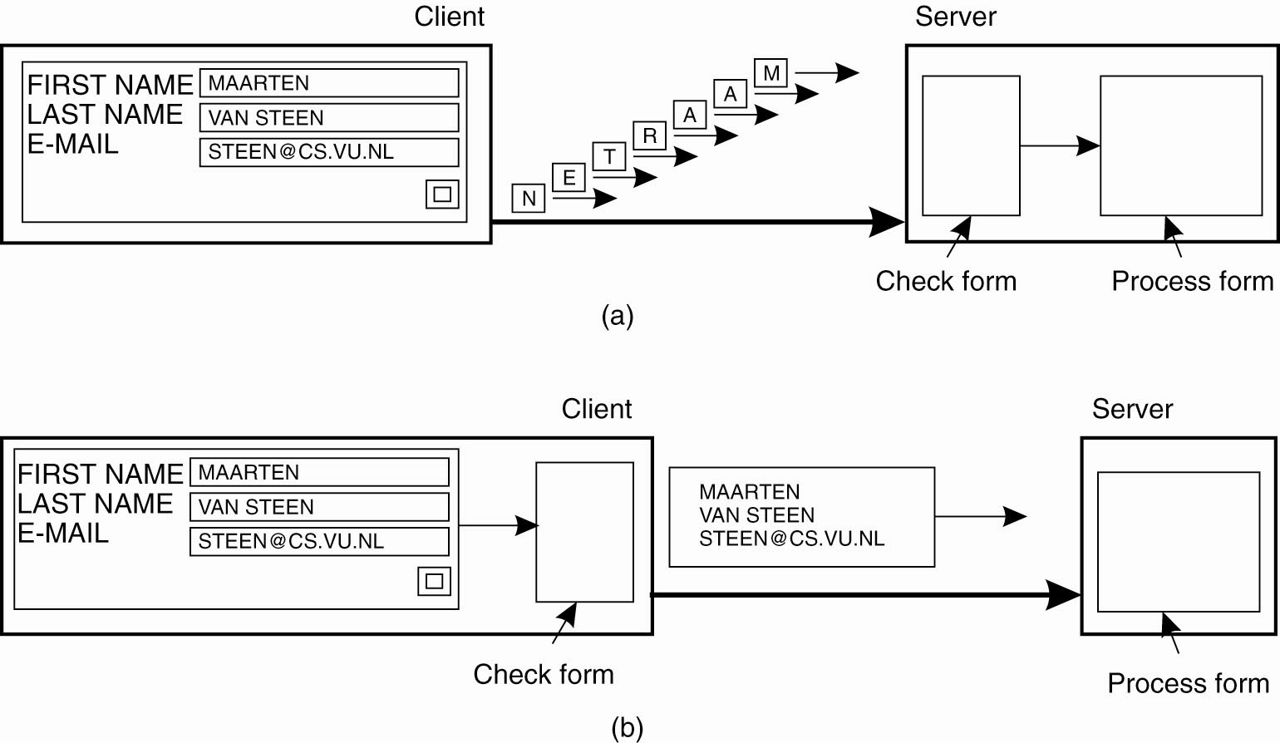
Reducing the Overall Communication
Figure: The difference between letting (a) a server or (b) a client check forms as they are being filled.

Slide 65

Example of Code Migration (3): Exploiting Parallelism
Searching for information in the Web
It is relatively simple to implement a search query in the form of a small mobile program (mobile agent) that moves from site to site
By making several copies of such a program and sending each off to different sites
A linear speed-up can be achieved
Notes:
What is mobile agent?

Slide 66
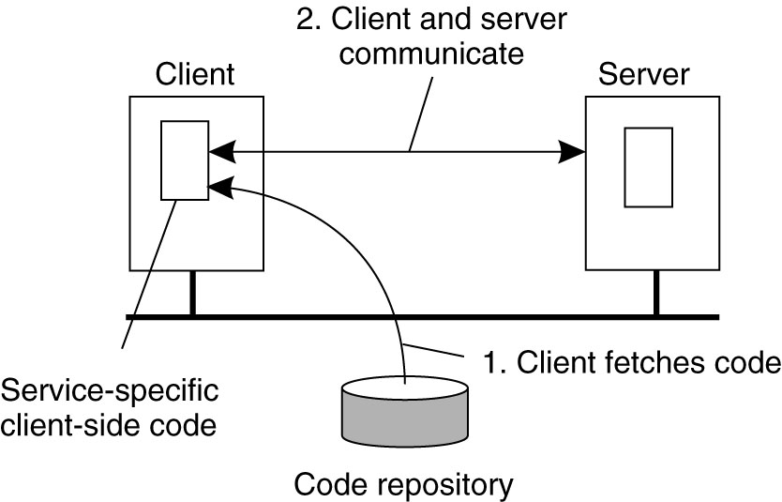
Dynamical Configuration of DS
Normally the client-side implementation of the file system interface requires special software installed on the client in advance
Alternative approach: let the server provide the client’s implementation no sooner than is strictly necessary, when the client binds to the server.
The client dynamically downloads the implementation
Subsequently invokes the server

Slide 67
Model of dynamically downloading client-side software
Clients need not have all the software preinstalled to talk to servers
Software can be moved in and discarded as necessary
As long as interfaces are standardized, the C/S protocol and its implementation can be changed
Changes will not affect existing client applications that rely on the server
Security problem

Slide 68
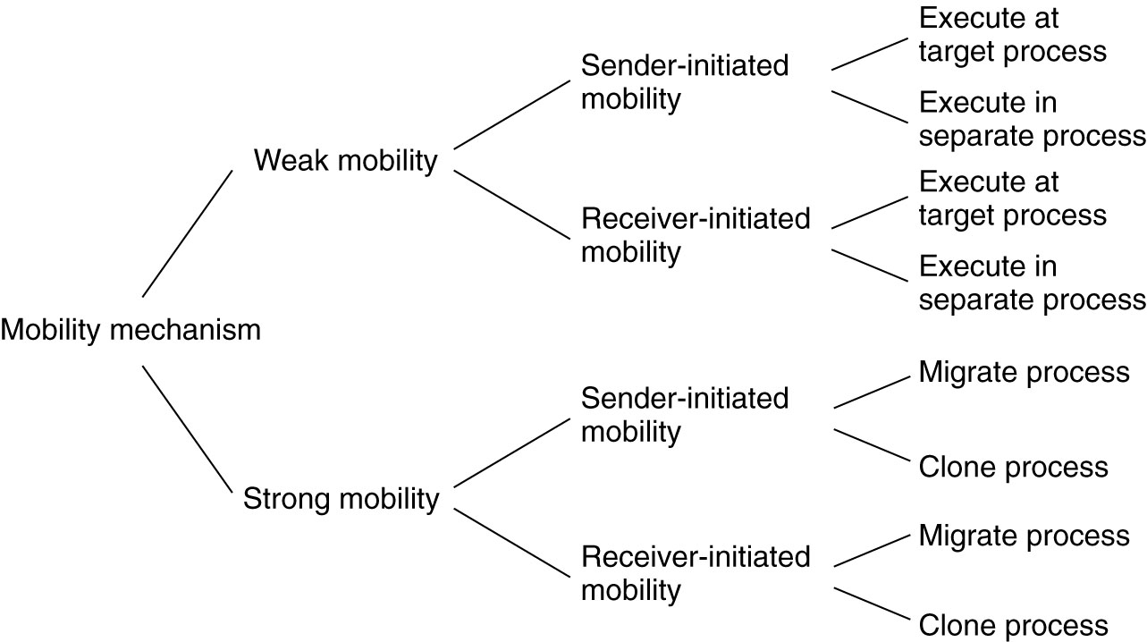
Models for Code Migration (1)

Slide 69
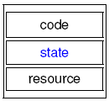
Models for Code Migration (2)
Code migration in the broadest sense: moving programs between machines with the intention to have those programs be executed at the target.
Traditionally communication in DS is concerned with exchanging data between processes
In some cases, the execution status of a program, pending signals, and other parts of the environment must be moved as well
A process consists of three segments
Code segment: set of instructions
Execution segment: store the current execution state of a process (consisting of private data, the stack and the program counter)
Resource segment: references to external resources (files, printers, devices, other processes, etc.)

Slide 70
Weak Mobility
Bare minimum for code migration
Transfer code segment (+ some initialization data)
Feature of simplicity: a transferred program is always started from one of several predefined starting positions
Requirement: the target machine can execute the code ⇨ making the code portable
Example: Java applets always start execution from the beginning

Slide 71
Strong Mobility
Transfer code segment + execution segment (state)
Feature: a running process can be stopped, subsequently moved to another machine, and then resume execution where it left off.
Observation: strong mobility is much more general than weak mobility, but also much harder to implement

Slide 72
Sender-/Receiver-Initiated Migration (1)
Sender-initiated migration: migration is initiated at the machine where the code currently resides or is being executed.
Typical example: uploading programs to a computing server.
Another example: sending a search program across the Internet to a Web database server to perform the queries at that server.
Receiver-initiated migration: the initiative is taken by the target machine.
Example: Java applets (Code on Demand)
Observation:
R is
simpler
than S
Notes:
A mobile agent is a specific form of mobile code, within the field of code mobility. However, in contrast to the Remote evaluation and Code on demand programming paradigms, mobile agents are active in that they can choose to migrate between computers at any time during their execution. This makes them a powerful tool for implementing distributed applications in a computer network.

Slide 73
Sender-/Receiver-Initiated Migration (2)
Code migration often occurs between a client and a server,
The client takes the initiative for migration and securely uploads code to a server,
requires that the client has been registered and authenticated at that server.
Reason – resource protection: the client will presumably want access to the server’s resources such as its disk.
Downloading code, can often be done anonymously.
Reasons:
the server is generally not interested in the client’s resources.
only for improving client-side performance and a limited number of resources need to be protected
sender-initiated migration
What kind of migration?
receiver-initiated case
What kind of migration?

Slide 74
Weak Mobility: Execution of Migrated at Target/Separate Process
Migrated code is executed by the target process.
Example: Java applets are simply downloaded by a Web browser and are executed in the browser’s address space.
Benefit: no need to start a separate process, thereby avoiding communication at the target machine.
Main drawback: the target process needs to be protected against malicious or inadvertent code executions.
A simple solution: let the operating system take care of that by creating a separate process to execute the migrated code.
Note: this solution does not solve the resource-access problems

Slide 75
Strong Mobility: Migrate Process and Clone Process
Strong mobility can be supported either by process migration or remote cloning
Cloning yields an exact copy of the original process, running on a different machine in parallel to the original one
Example: In UNIX systems, remote cloning takes place by forking off a child process and letting that child continue on a remote machine.
Benefit of cloning:
the model closely resembles the one that is already used in many applications.
a simple way to improve distribution transparency

Slide 76
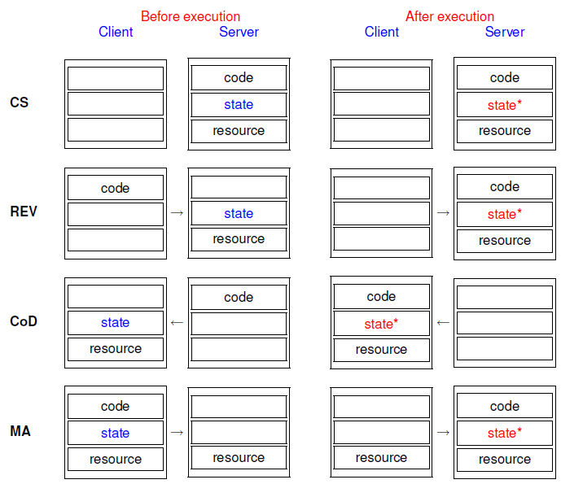
Code Migration: Some Context
Client-Server
Remote Evaluation
Code on Demand
Mobile Agent

Slide 77
Code Migration
Approaches to code migration
Migration and local resources
Migration in heterogeneous systems

Slide 78
Migration and Local Resources (1)
Problem
An object uses local resources that may or may not be available at the target site.
Resource types (resource-to-machine bindings)
Fixed: the resource cannot be migrated and are bound to a specific machine or environment (e.g., local devices)
Fastened: the resource can, in principle, be migrated but only at high cost (e.g., local databases, complete Web sites)
Unattached: the resource can easily be moved along with the object (e.g. a cache or data files)
Notes:
So far, only the migration of the code and execution segment has been taken into account. The resource segment requires some special attention. What often makes code migration so difficult is that the resource segment cannot always be simply transferred along with the other segments without being changed.
When migrating code, we often need to change the references to recourses, but cannot affect the kind of process-to-resource binding. If, and exactly how a reference should be changed, depends on whether that resource can be moved along with the code to the target machine. More specifically, we need to consider the resource-to-machine bindings, and distinguish the following cases.

Slide 79
Migration and Local Resources (2)
Strongest
Process-to-resource binding
By identifier: the object requires precisely the referenced resource (e.g., a URL referring to a specific Web site; a specific database)
By value: the object requires the value of a resource (e.g., referring to standard libraries; the set of cache entries)
By type: the object requires that only a type of resource is available (references to local devices, such as monitors, printers)
Weakest
Notes:
Binding by value: When a program relies on standard libraries, such as those for programming in C or Java. Such libraries should always be locally available, but their exact location in the local file system may differ between sites. Not the specific files, but their content is important for the proper execution of the process.

Slide 80
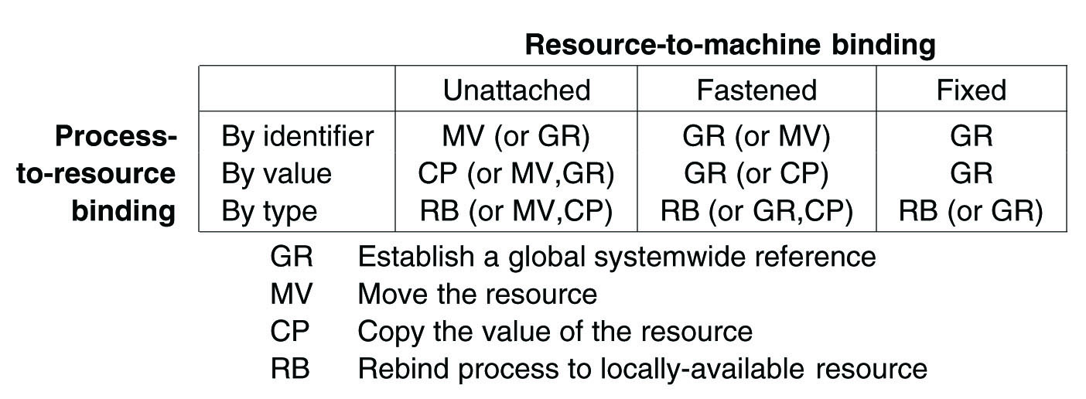

Actions to be taken with respect to the references to local resources
Note
Establishing a global reference may be more than just making use of URLs
The use of a global reference is sometimes prohibitively expensive
Notes:
Combining three types of process-to-resource bindings and three types of resource-to-machine bindings, leads to nine combinations that we need to consider when migrating code.

Slide 81
Code Migration
Approaches to code migration
Migration and local resources
Migration in heterogeneous systems

Slide 82
Migration in Heterogeneous Systems
Main problem
The target machine may not be suitable to execute the migrated code
The definition of process/thread/processor context is highly dependent on local hardware, operating system and runtime system
Current best solution to handle heterogeneity
Make use of virtual machines that is implemented on different platforms:
Notes:
So far, we have tacitly assumed that the migrated code can be easily executed at the target machine. This assumption is in order when dealing with homogeneous systems. In general, however, distributed systems are constructed on a heterogeneous collection of platforms. Migration in such systems requires that each platform is supported.

Slide 83

Summary
Threads in DS are particularly useful to continue using the CPU when a blocking I/O operation is performed.
Organizing a DS in terms of clients and servers has proven to be useful.
Client processes generally implement user interfaces and furthermore aim at achieving distribution transparency.
Servers are often more intricate than clients, but are nevertheless subject to only a few design issues
An important topic of DS is the migration of code between different machines
Two reasons: increase performance and flexibility
Current practice indicates that the best solution to handle heterogeneity is to use virtual machines

